Slide 1



Course: Image Processing 31651 Assignment #24 Pixel to Pixel Operations (Part 4)
1
Photo of the student | Shorten Name | ID (4 last digits)
 | shienfeld | 1950 | Student #1
 | pony | 2210 | Student #2
 | akimov | 7939 | Student #3
Photo of the student | Shorten Name | ID (4 last digits)
 | shienfeld | 1950 | Student #1
 | pony | 2210 | Student #2
 | akimov | 7939 | Student #3

Slide 2
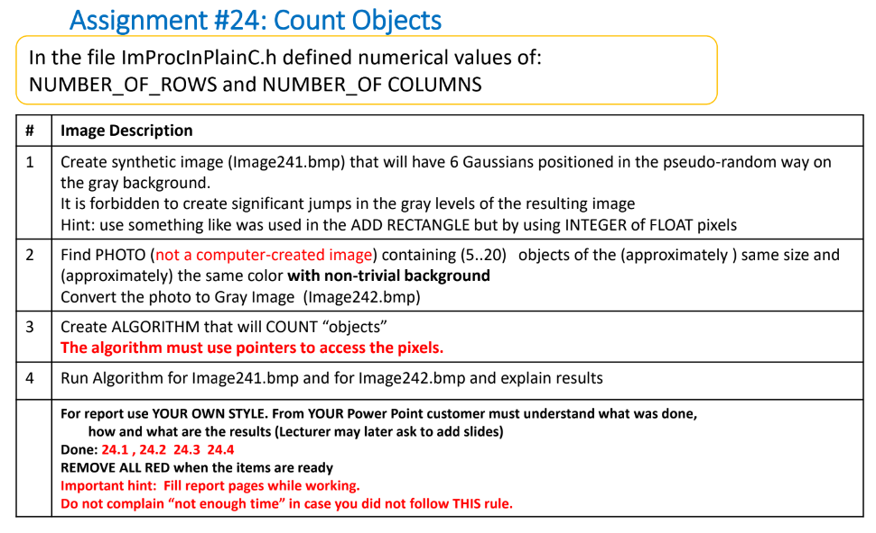
Pay attention : due to the complexity of the code and the complexity of the order of operations in the code – the functions will be explained first and only after that the connectivity to the task will be explained. Every function will be explained as an “isolated part” of the entire program.

Slide 3
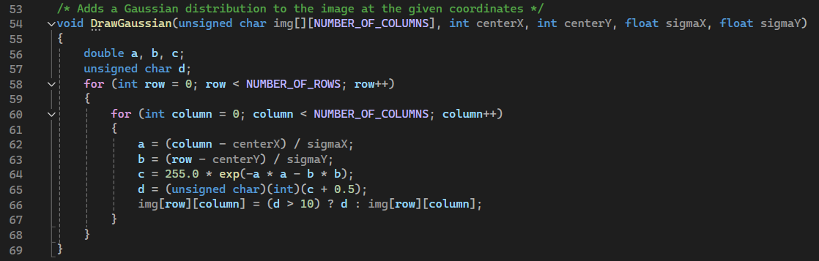
24.1 – “DrawGaussian” function
The DrawGaussian function is designed to add a Gaussian distribution to an image at specified coordinates.
For each pixel located at (row, column), the function calculates the value of the Gaussian distribution at that point.
a and b are the normalized distances from the center of the Gaussian in the x and y directions, respectively.
The Gaussian value c is then calculated using the formula for a 2D Gaussian distribution:
d is the Gaussian value rounded to the nearest integer.
The function updates the pixel value at (row, column) in the image array img:
If the calculated Gaussian value d is greater than 10, the pixel value is updated to d. If d is less than or equal to 10, the pixel value remains unchanged.
Why do we do it?

Slide 4
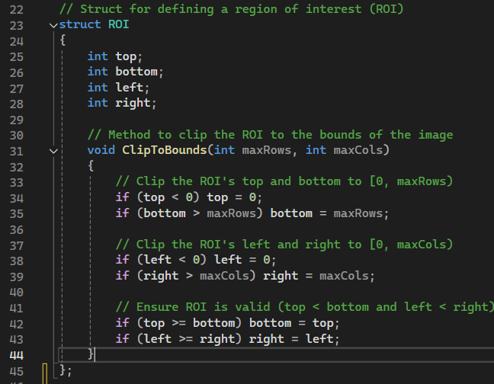
24.2 – “ROI (region of interest)” struct
The primary purpose of the ROI struct is to define a rectangular area within an image where certain operations will be applied.
This allows focusing on specific parts of the image rather than processing the entire image.
void ClipToBounds is a method to ensure the ROI is within the bounds of the image. It adjusts the top, bottom, left, and right properties to make sure they do not exceed the image dimensions.
Summary : we created the ROI as a useful tool for later counting operation (of objects or gaussians). In the next slides the usefulness of the ROI will be clarified!

Slide 5
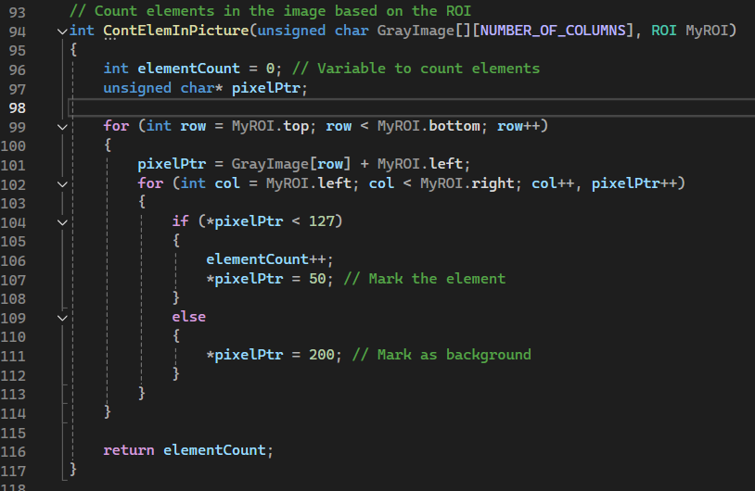
24.3 – “ContElemInPicture” function
This function is designed to count elements in a specified region of interest (ROI) in a grayscale image and to mark these elements and the background.
The function counts the number of elements (pixels) within a specified ROI in a grayscale image where the pixel values are below a certain threshold (127 in this case).
It also marks the pixels that are considered elements and those that are considered background.
Pay attention : pixelPtr is declared as a pointer to traverse the pixel values in the image. All the operations will be applied on that pointer.

Slide 6
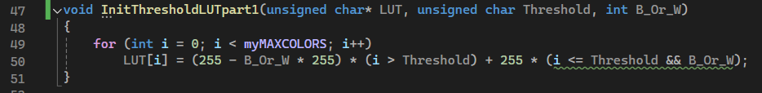
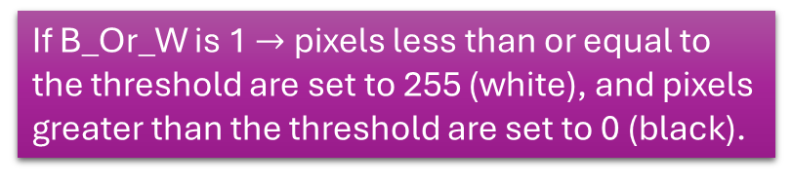
24.3 – “InitThresholdLUTpart1” function
The InitThresholdLUTpart1 function initializes a Lookup Table for thresholding a grayscale image.
The LUT is used to map the pixel values based on a specified threshold, either making them black or white depending on whether they are above or below the threshold.
Pay attention – one of the input of the function is a pointer to the LUT which was defined as global.
B_Or_W is a flag that determines the output value for pixels based on the threshold
If B_Or_W is 1 $→$ pixels less than or equal to the threshold are set to 255 (white), and pixels greater than the threshold are set to 0 (black).
If B_Or_W is 0, pixels less than or equal to the threshold are set to 0 (black), and pixels greater than the threshold are set to 255 (white).

Slide 7
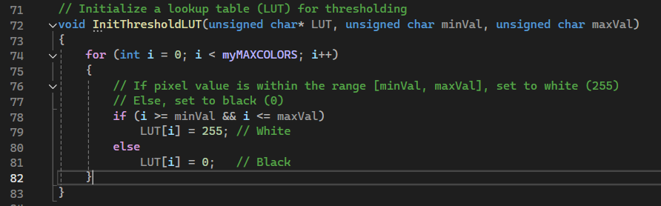
24.4 – “InitThresholdLUT” function
The InitThresholdLUT function initializes a Lookup Table for thresholding a grayscale image.
The LUT maps pixel values to either black (0) or white (255) based on a specified range of values – this is the difference from the other function InitThresholdLUTpart1.
Pixels within the range are set to white, and pixels outside the range are set to black.
Pay attention:
We thought that creating two functions for initializing LUT is the preferred way to approach the two very different tasks within that assignment.
Although we will always prefer to write the most generic function that possible – here we decided to do different
The function is used to create a binary thresholding effect on a grayscale image.
By converting pixel values within a specified range to white and those outside the range to black, we can separate objects or features of interest from the background.

Slide 8
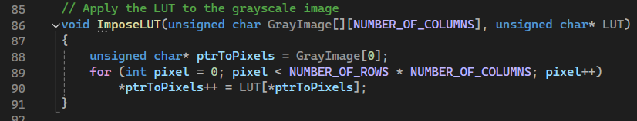
24.5 – “ImposeLUT” function
After defining the LUT – we need to apply the LUT of the original gray image.
ptrToPixels is initialized to point to the first pixel of the image.
Since GrayImage is a 2D array, GrayImage[0] points to the first row, and ptrToPixels thus points to the first pixel in that row.

Slide 9
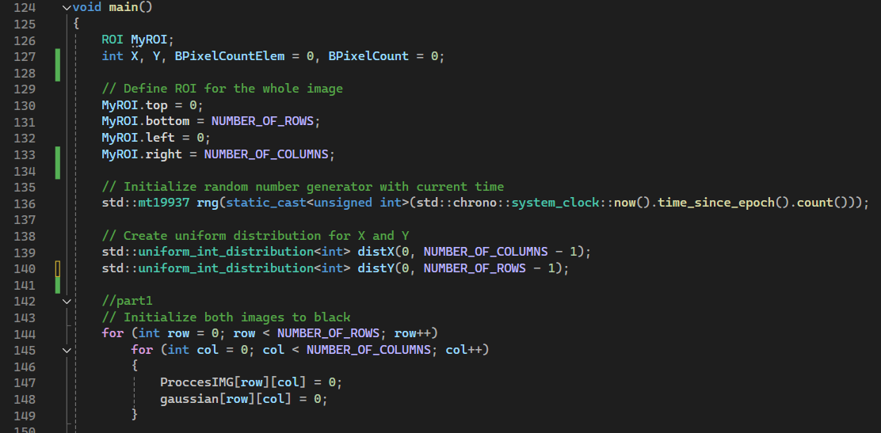
24.6 – “main” function – part 1
This part of the “main” sets up the necessary variables and data structures, initializes random number generation, and prepares the images for further processing steps that will follow in the rest of the main function.
That line’s purpose is to create a seeded random number generator for generating random coordinates or values later in the code.
These line’s purpose is To define distributions for generating random coordinates within the image dimensions.
This double loop initializes all pixels in both ProccesIMG and gaussian images to black.

Slide 10
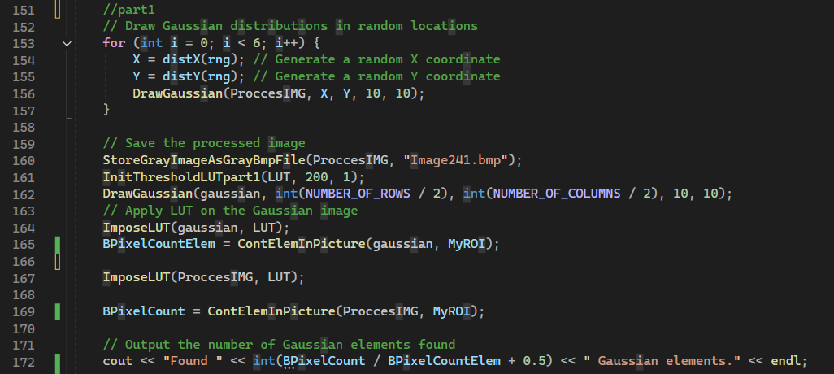
24.6 – “main” function – part 2
This part performs image processing operations to draw Gaussian distributions, apply thresholding using LUTs, count elements, and output the results.
distX(rng) or distY(rng) : Generates a random X or Y coordinate within the image bounds using the previously defined uniform distribution.
Calls the DrawGaussian function to add a Gaussian distribution centered at (X, Y) with standard deviations of 10 in both the X and Y directions in the ProccesIMG image.
Initializes the LUT array with a threshold of 200 and the flag B_Or_W set to 1
Draws a Gaussian distribution centered at the middle of the gaussian image with standard deviations of 10 in both the X and Y directions.

Slide 11
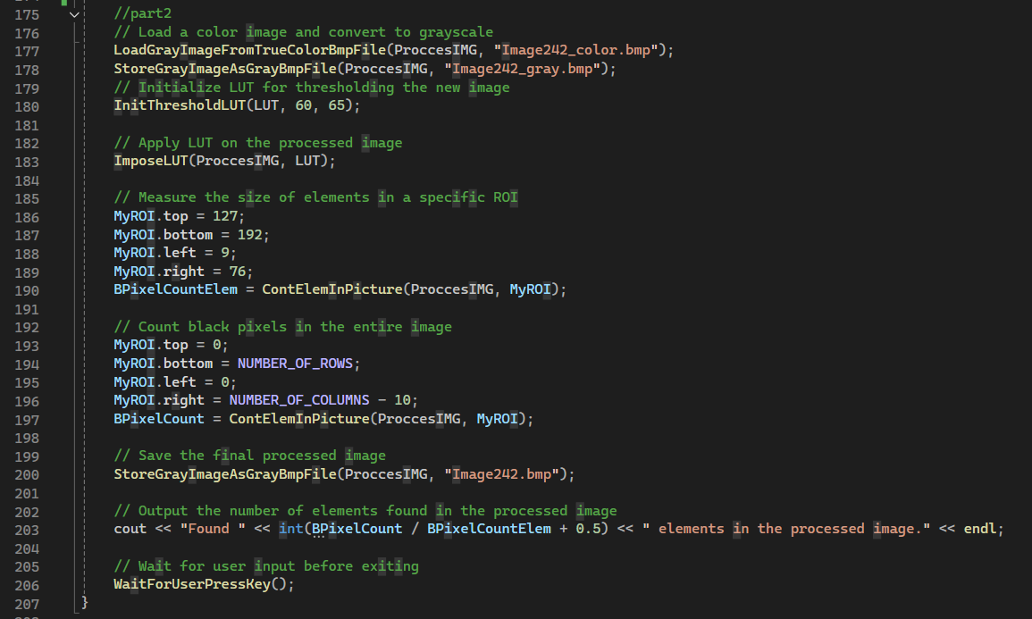
24.6 – “main” function – part 3

Slide 12
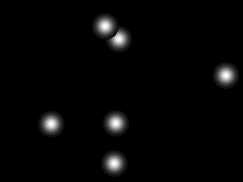
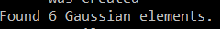
24.7 – created images and the counting results – part 1
Image241.bmp

Slide 13
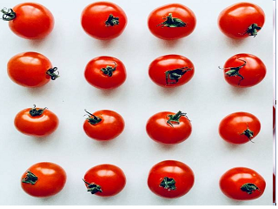
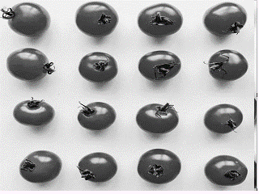
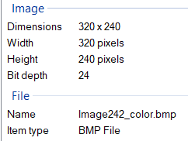
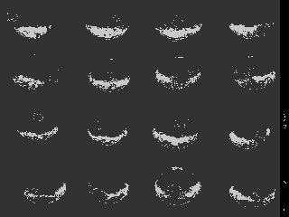
24.7 – created images and the counting results – part 2
Image242_color.bmp
Image242_gray.bmp
input

Slide 14
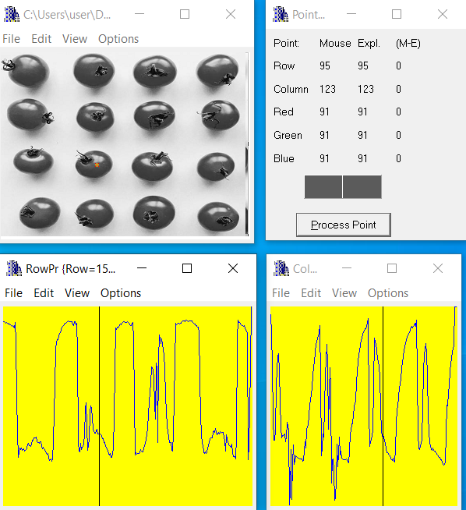
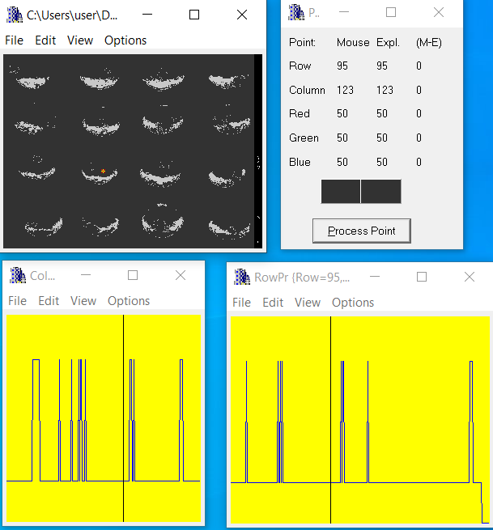
24.7 – created images' profiles– part 2

Slide 15
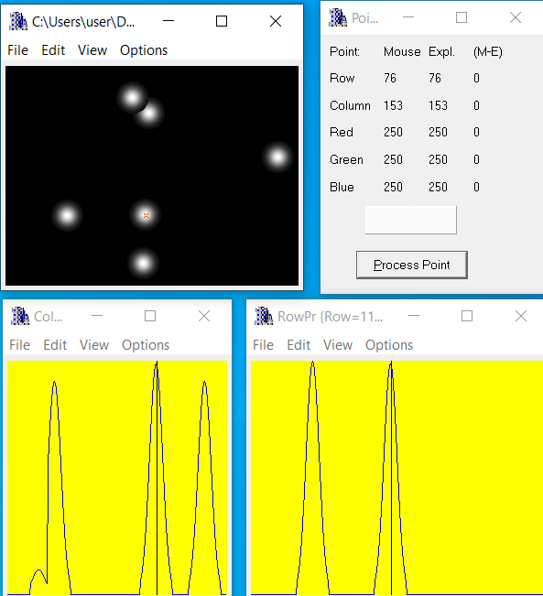
24.7 – created images' profiles– part 3

Slide 16
24.8 – what did we learn?
How to count similar objects in ones picture
This method works with a few condition:
Same objects sizes
Same objects color
The objects should be as whole and not sliced in the middle with the same kind of object.
If the objects are approximate Same size and color we are getting results near the accepted ones

